Slide 1
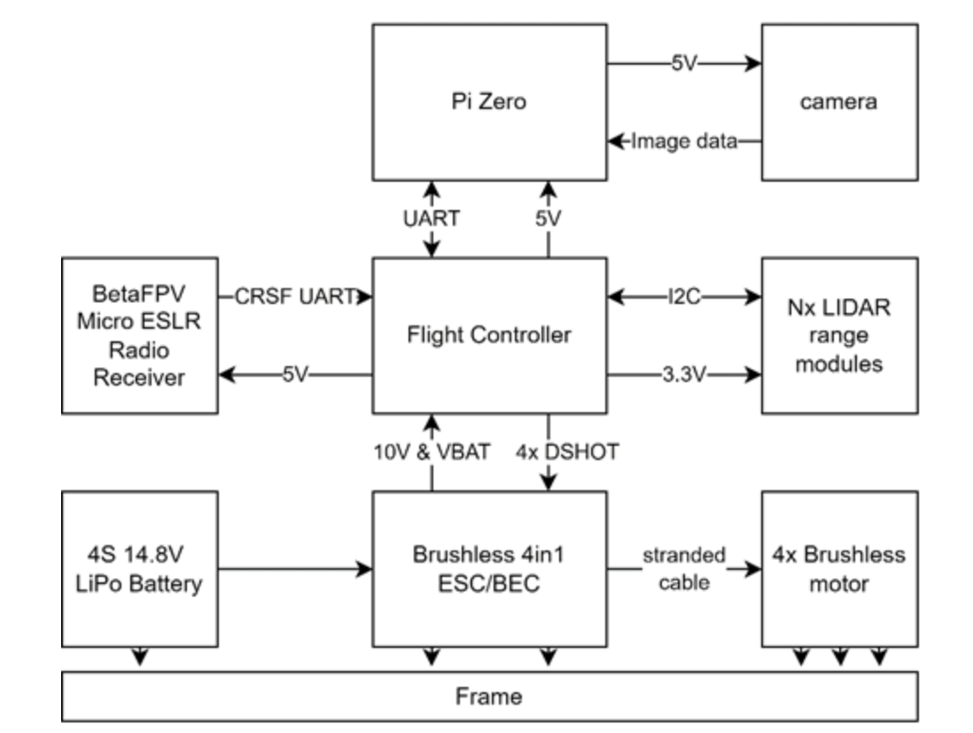
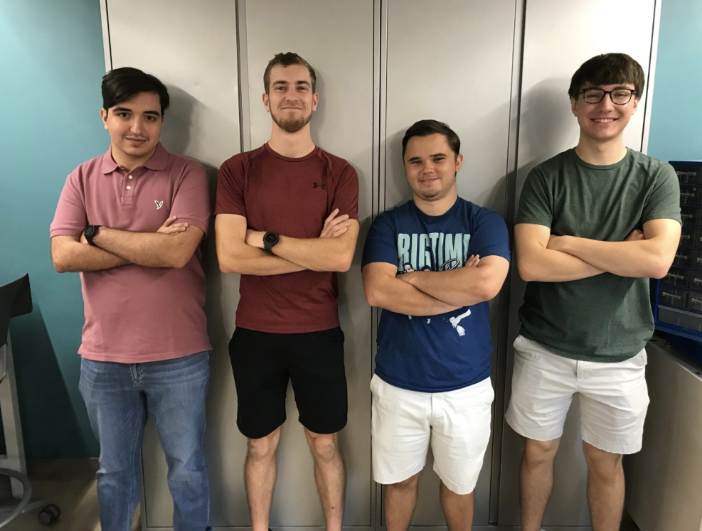
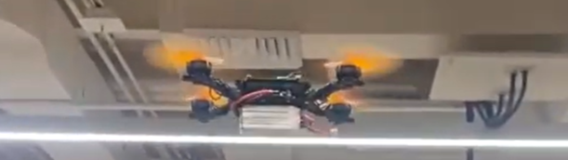
ECE 477 Digital Systems Senior Design Project – Fall 2022
Team 8 / Hermes
Problem: Building collapse is still a difficult and unsolved problem in emergency response. Buildings are unstable and very difficult for first responders to enter and navigate, meaning many are left injured and in need of rescue.
Project Goal: Assist rescues in their task of finding injured peoples and make their job safer.
Our Solution: An automated drone that uses a custom flight controller, and LIDAR sensors & camera with a Pi Zero to calculate and follow a flight path to move around inside a building to identify where people are found.
Microcontroller and Support Circuitry:
Pi Zero, Pi Camera, TMF8801 1D Time-of-flight sensor, VL53L1X Time of Flight Sensor, T-Motor Velox V2 ESC, and our microcontroller is the STM32F446
Hermes Team
From Left to Right: Santiago Garcia, Michael Langford, Owen Mandel, Jon Wosiak

Slide 2
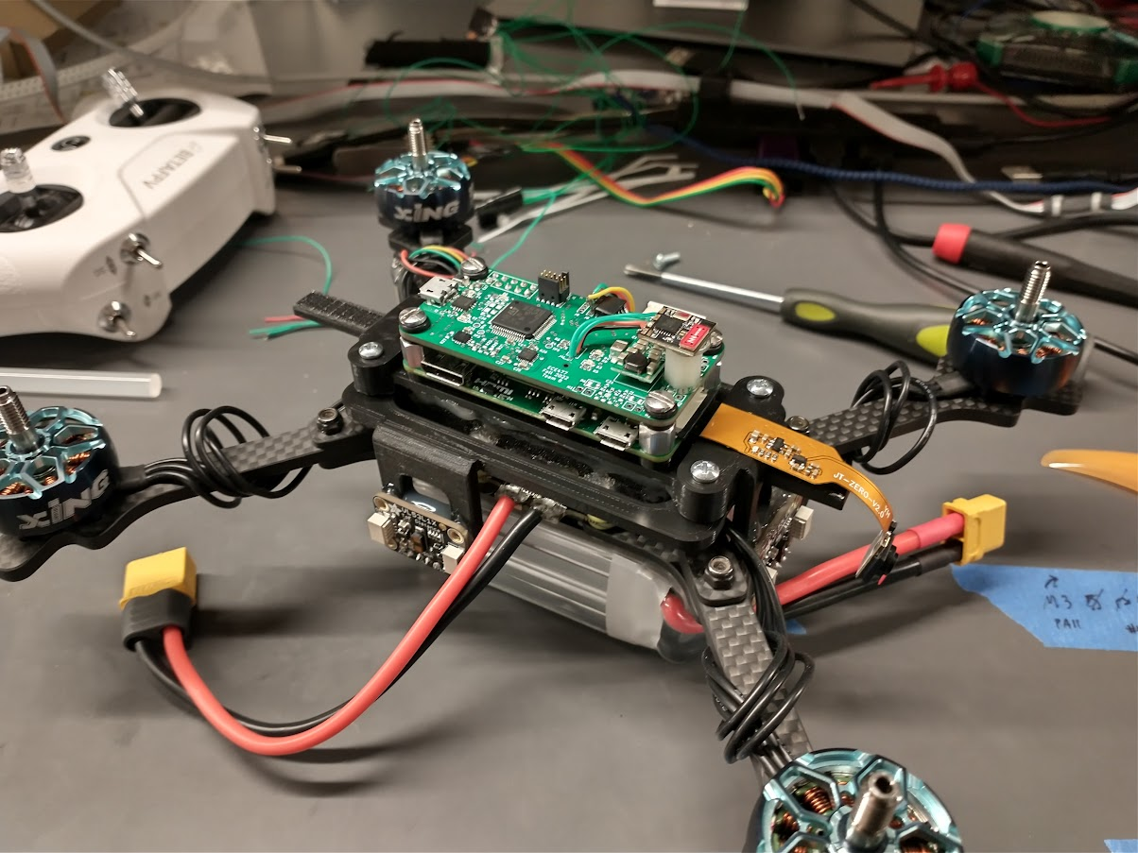
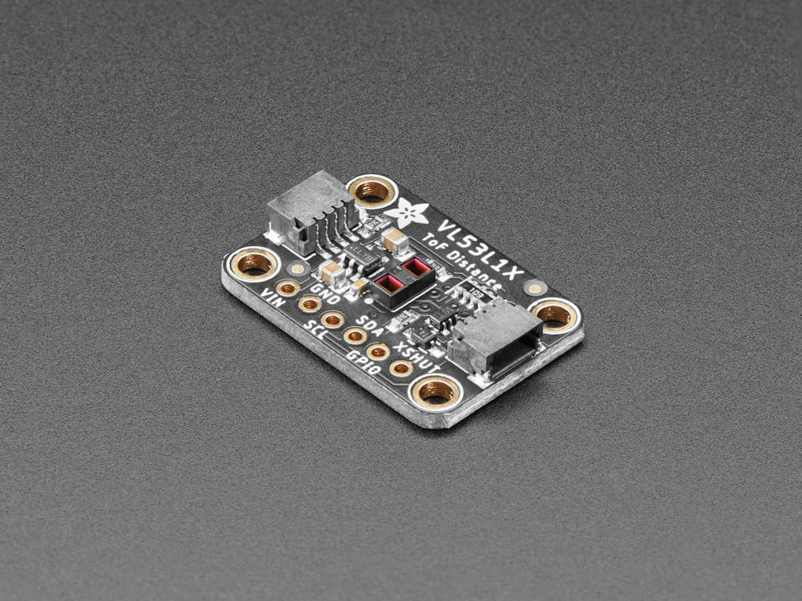
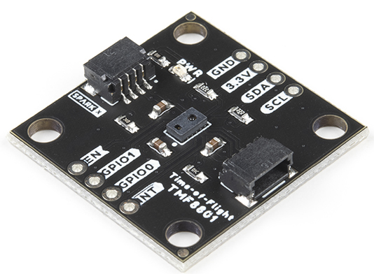
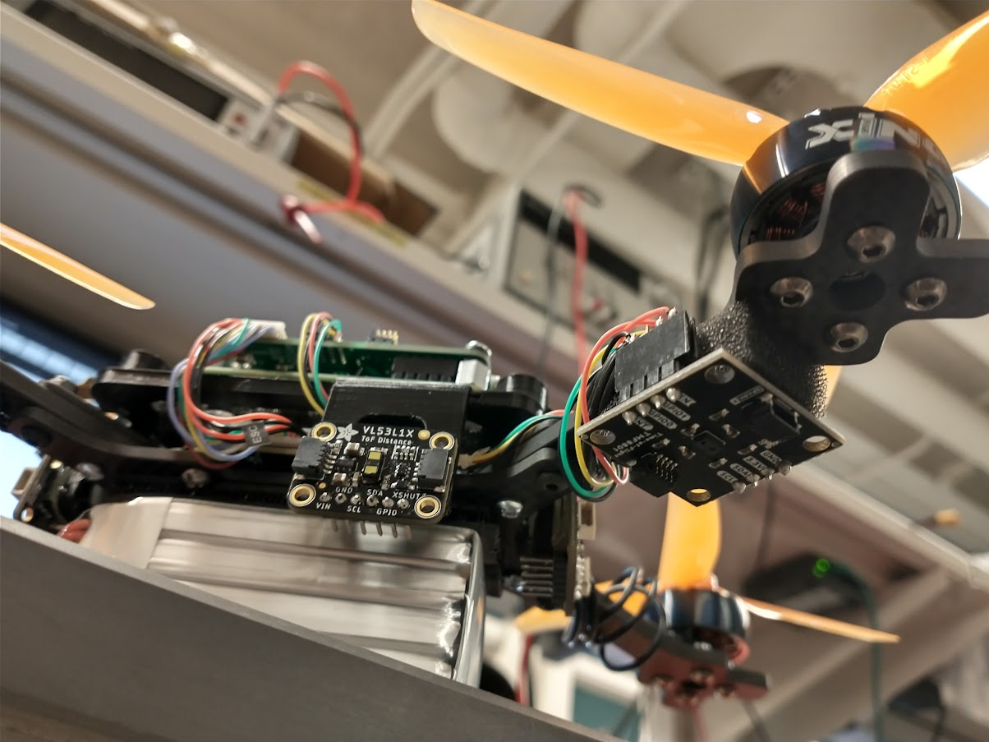
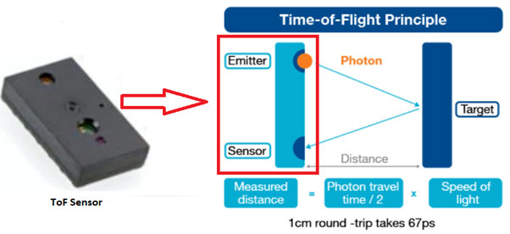
LIDAR Sensors:
The LIDAR sensors will be placed at the front, back, left and right of the drone. The 4 VL53L1X will be connected to the Pi Zero and the TMF8801 is connected to the microcontroller.
(credit: Stmicro)

Slide 3
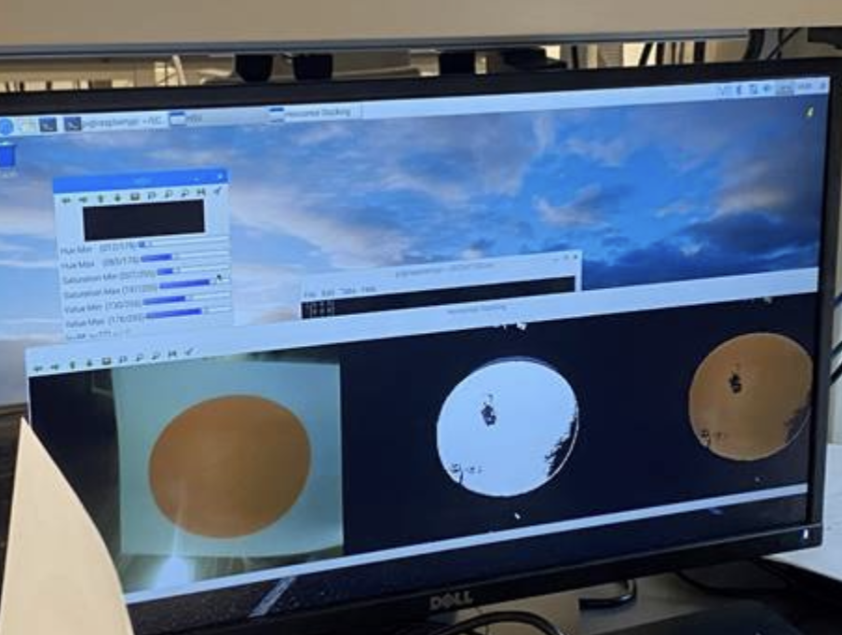
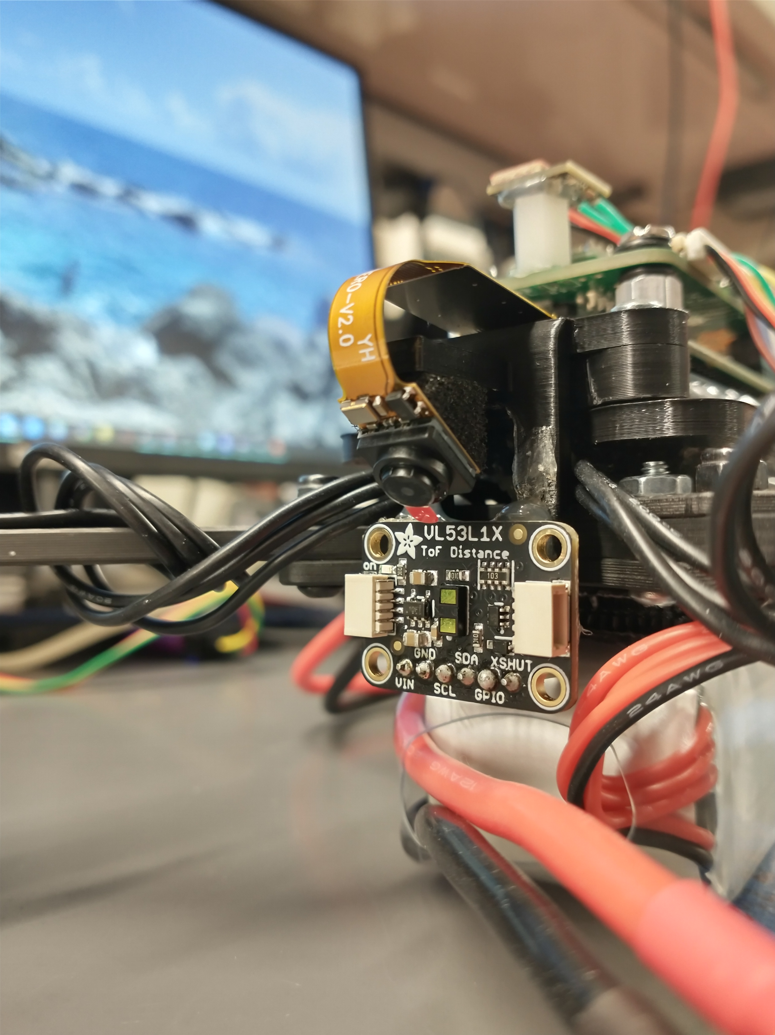
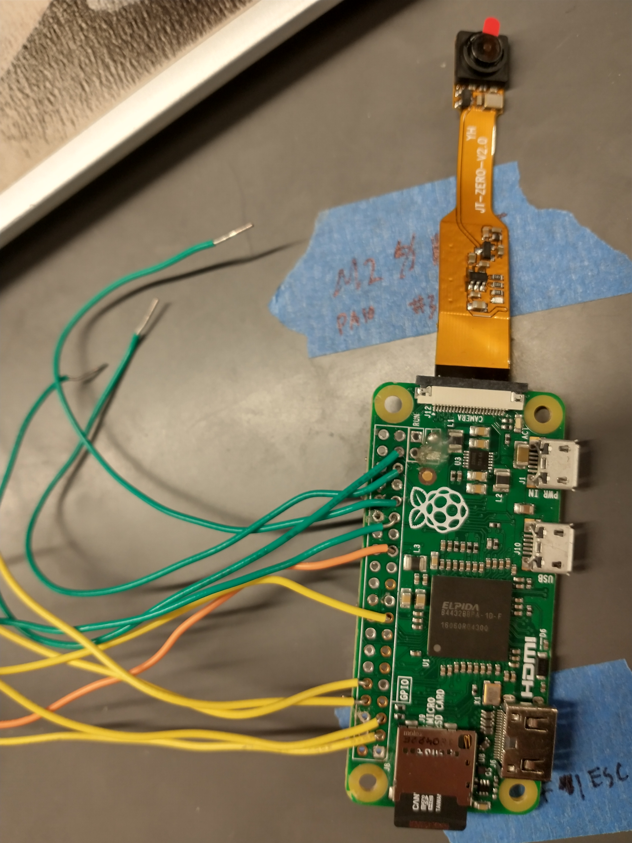
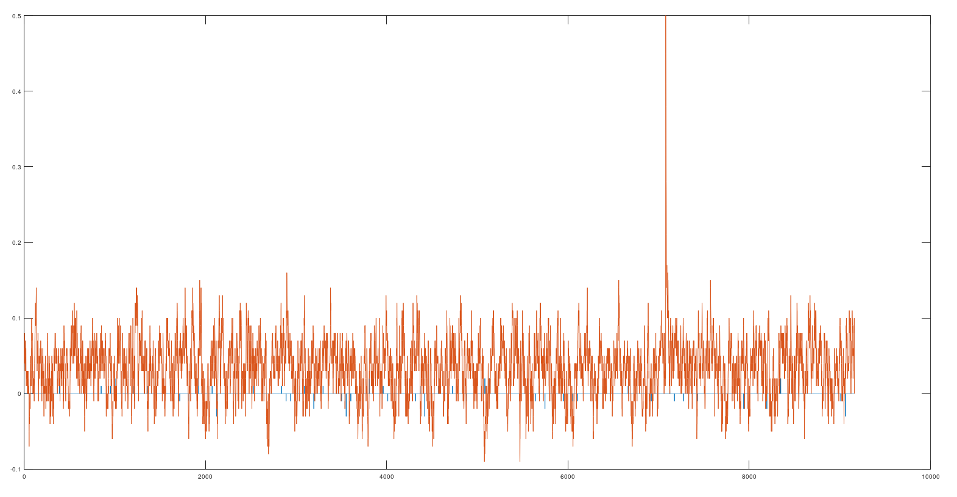
Pi Zero /Pi Cam
The Pi Zero will be used as the navigation computer and tell us when we have found our target, using color detection.
Pi Cam
Pi Zero

Slide 4
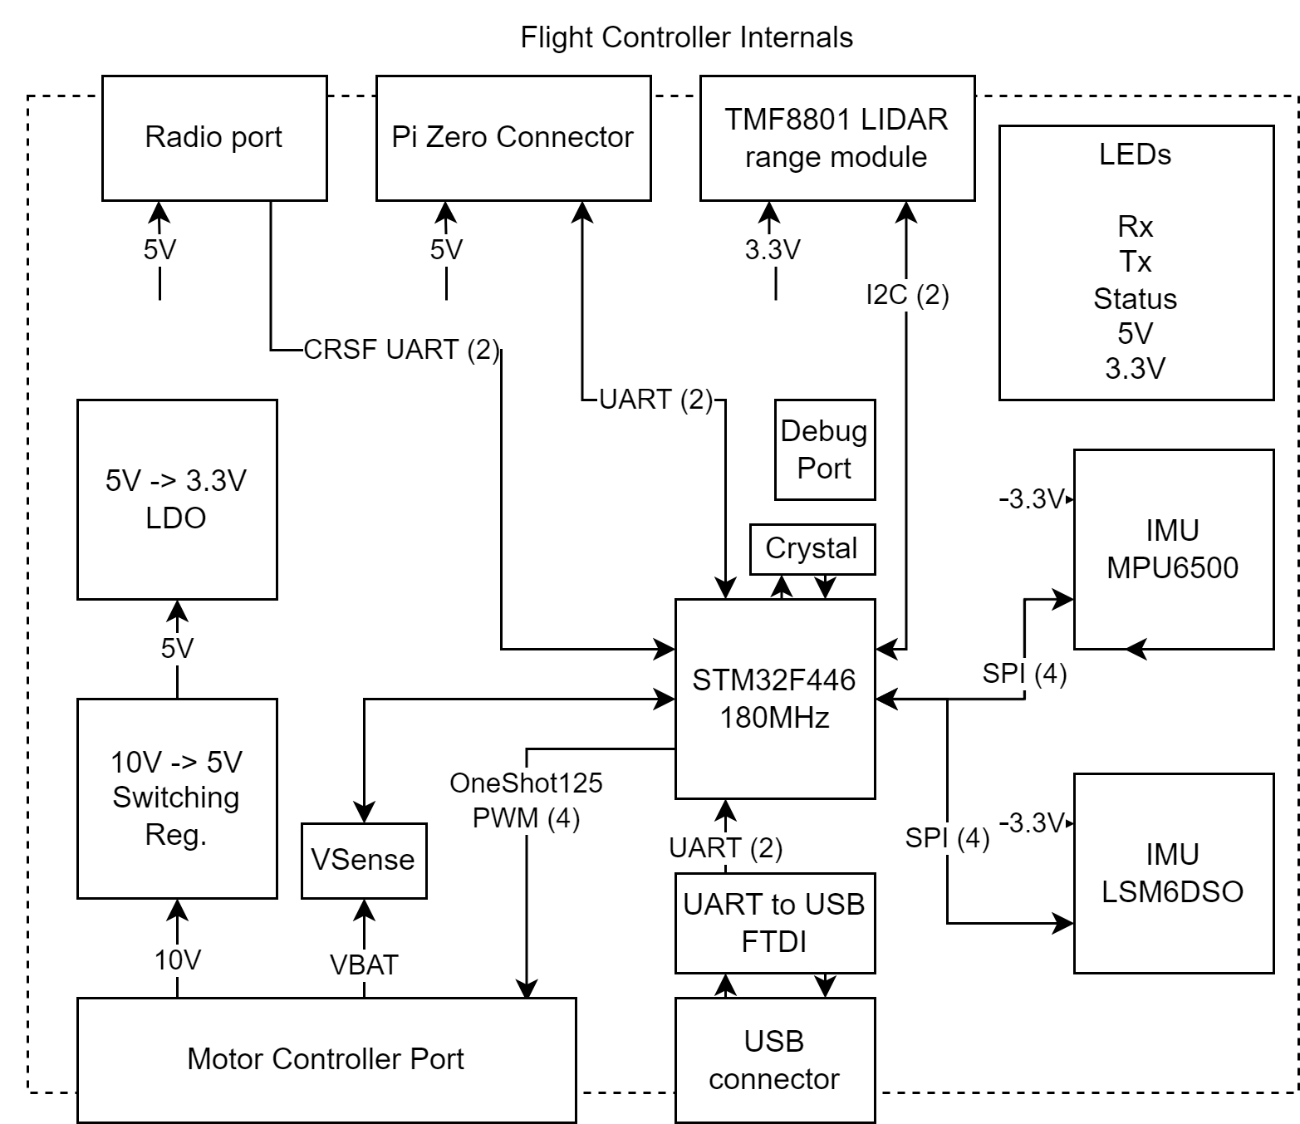
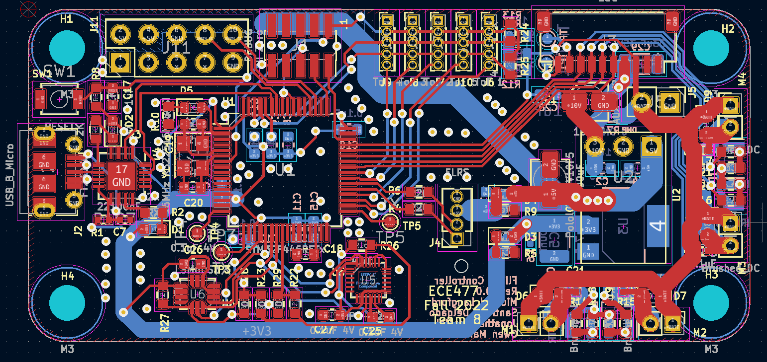
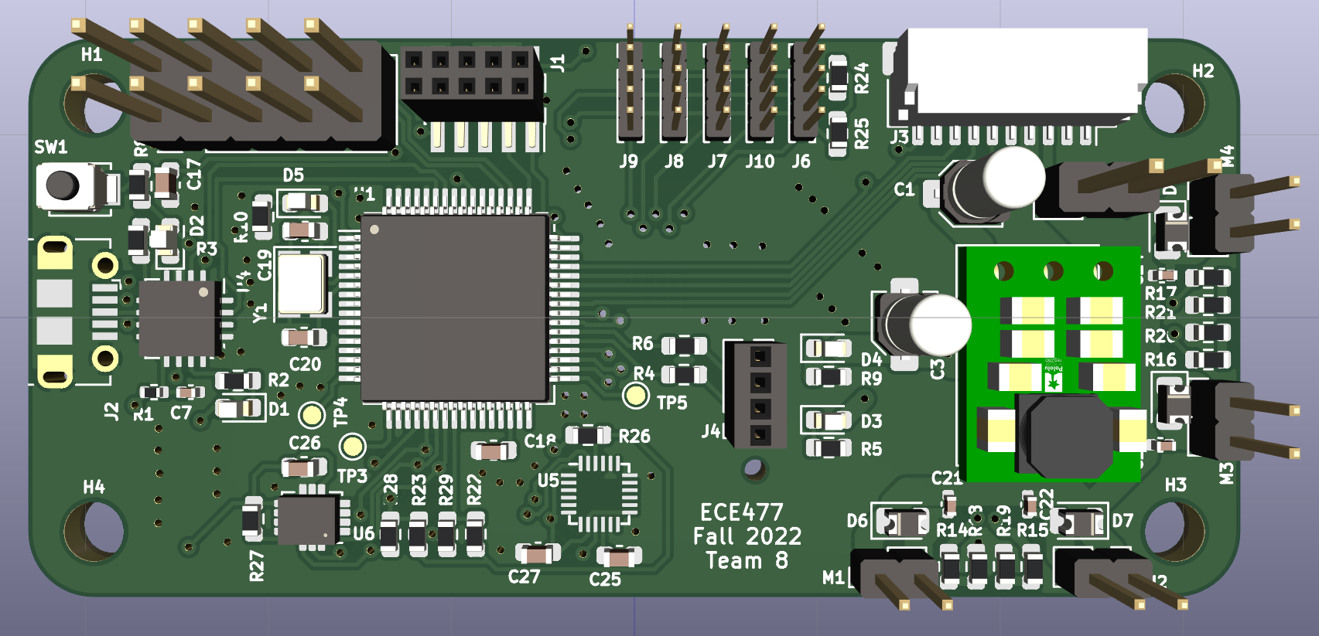
Custom Flight Controller
STM32F446, 12DoF IMU, CRSF Radio, OneShot125 PWM, Pi & USB UART
Completely custom flight controller, uses IMU, PID loops, and sensor fusion algorithms to auto-stabilize drone.
Nearly 0 library code, fully custom HW & SW

Slide 5
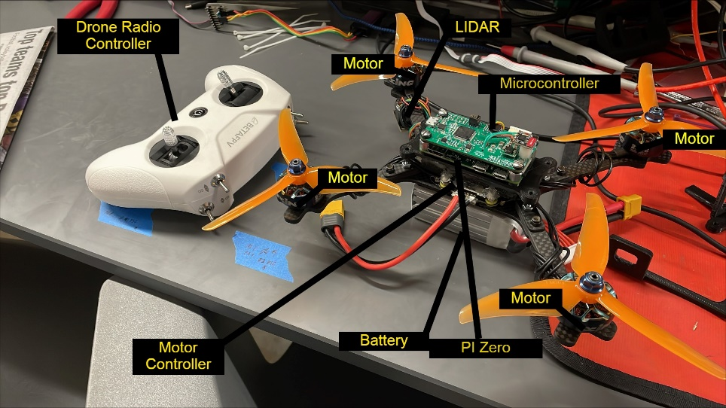

Slide 6
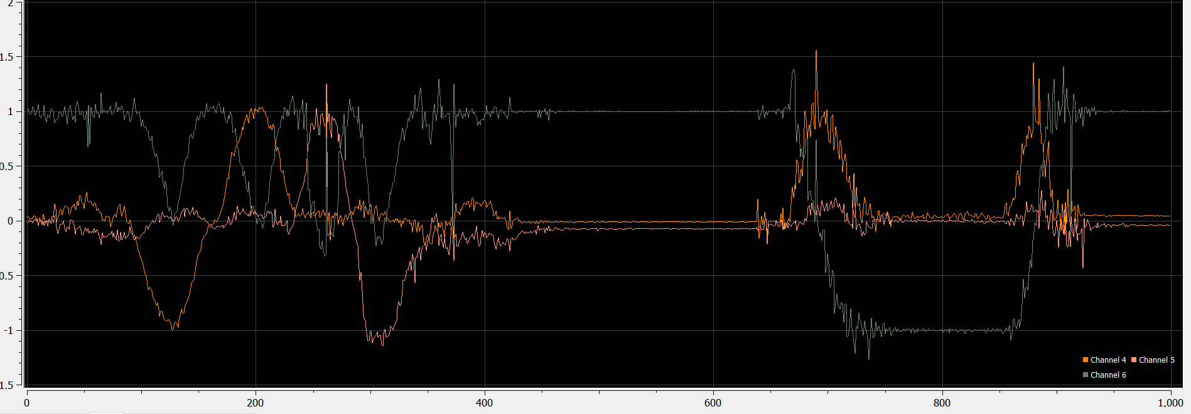
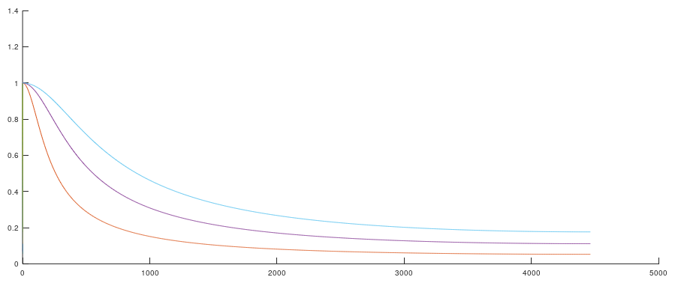
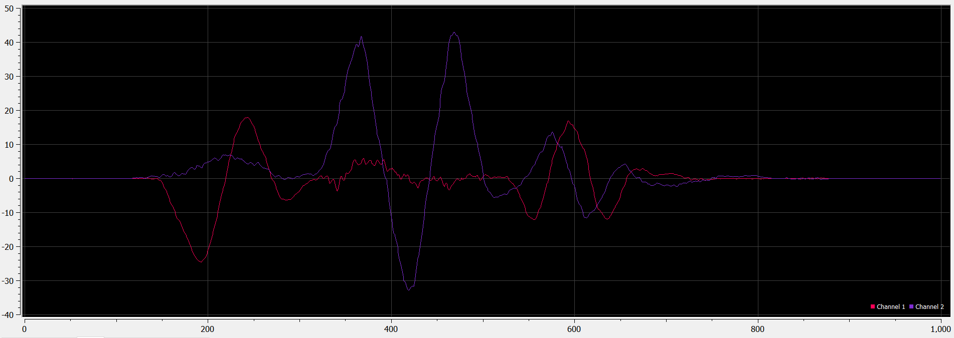
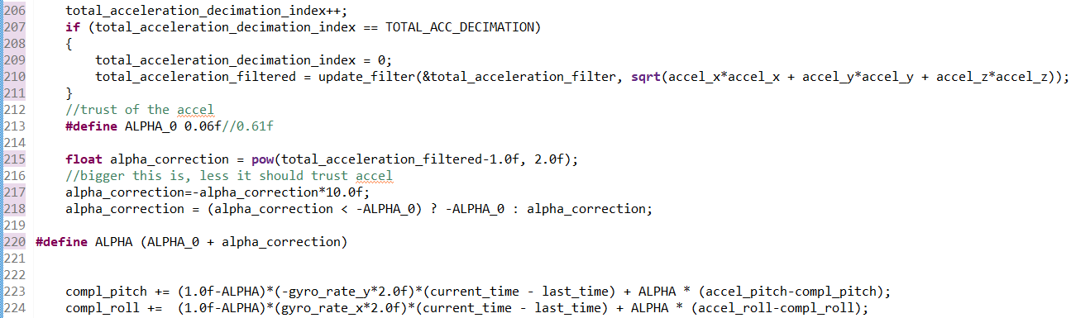

IMU
The two onboard IMU gyroscope and accelerometers allow for the drone to stay stable in flight
$$y\left[n\right]=ky\left[n−1\right]+\left(1−k\right)x[n]$$
$$\frac{Y\left(z\right)}{X\left(z\right)}={\left.\frac{k}{1−\left(1−k\right)z^{−1}}\right|}_{z=jω}$$
IIR filter implementation within atan2 conversion
Low Pass filter on high-sample rate gyro and accelerometer data
IIR filter for accelerometer, senses gravity vector, converts to pitch and roll
Complementary Filter combines low noise angular rate with noisy but long-term reliable accelerometer heading (essentially a combination of high-pass and low pass IIR filter)
Complementary filter cutoff parameter varied based on noise power and movement sensed on accelerometer, varying the filter from trusting the accelerometer during low noise, to trusting the gyro during high noise and acceleration
(ALPHA parameter in code to the left varied based on acceleration level)

Slide 7
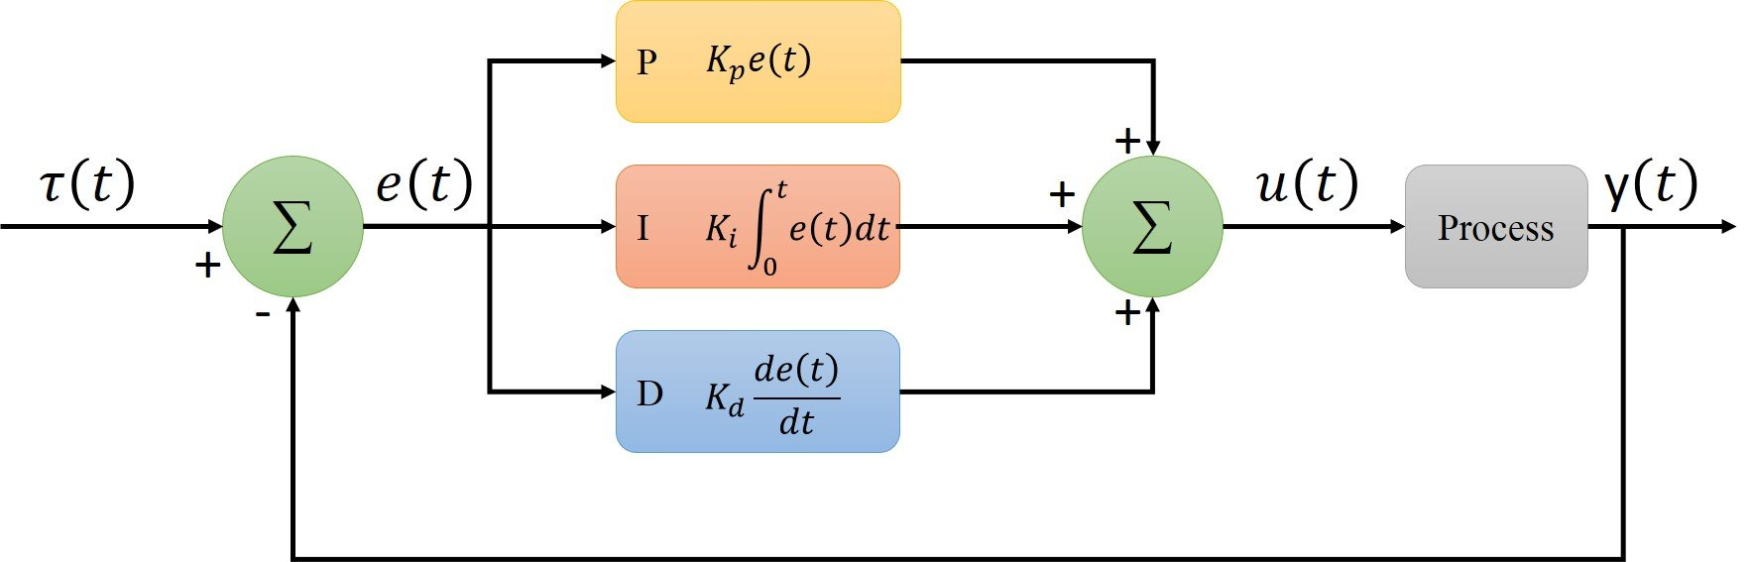
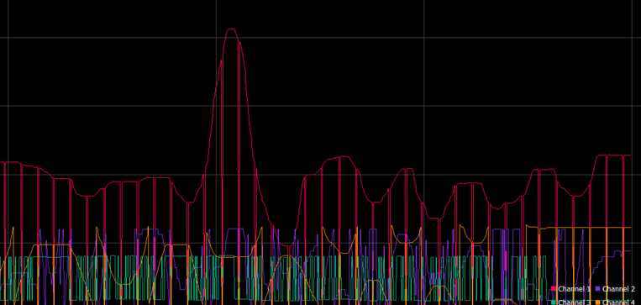
PID Loops & Radio
Takes sensor data and computes controlled response to stabilize the drone
3 PID loops for Yaw, Pitch, and Roll stabilization
1 PID for throttle (based off ToF Z sensor data
2 PID (on Pi Zero) for spatial control (using ToF XY data)

Slide 8
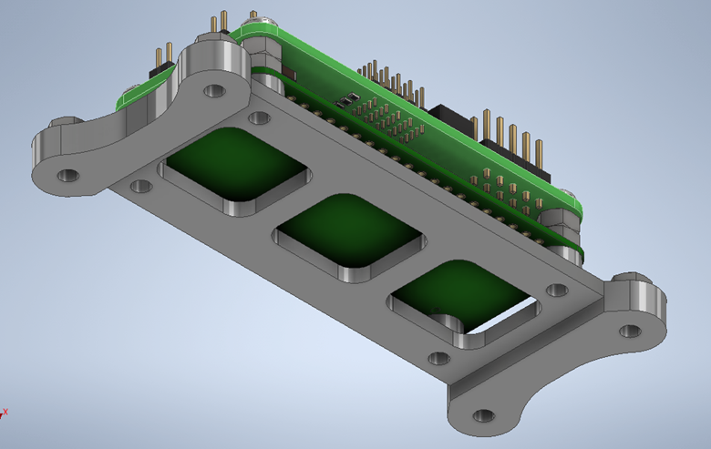
3D Prints & Frame

Slide 9
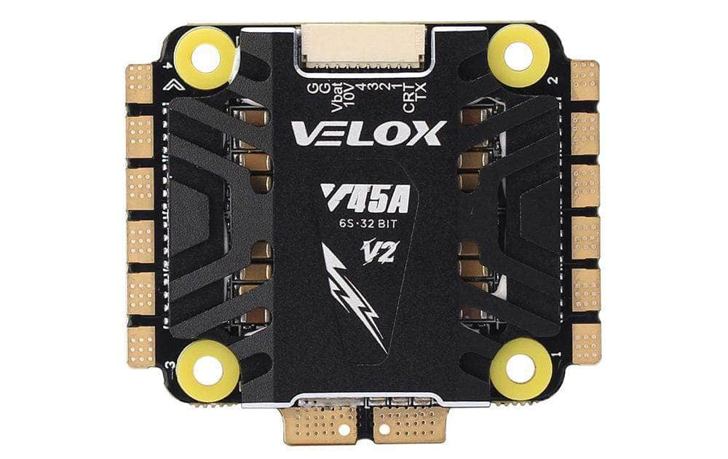
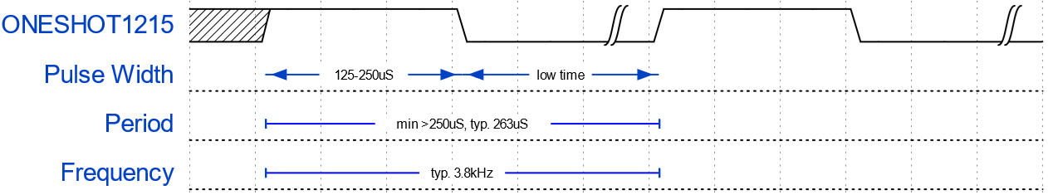
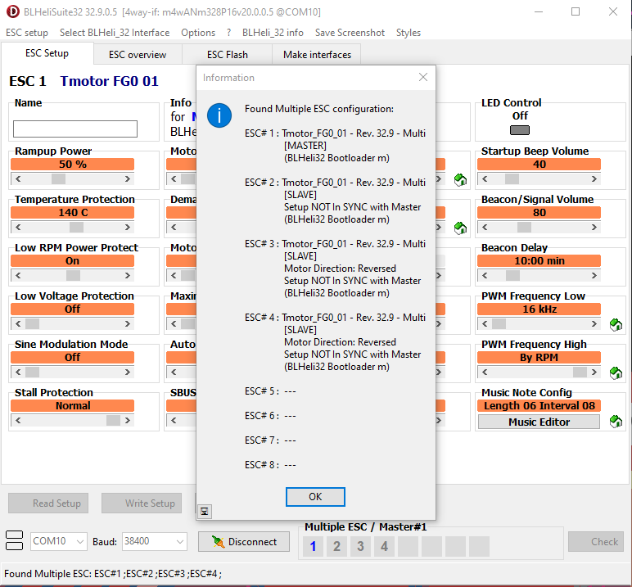
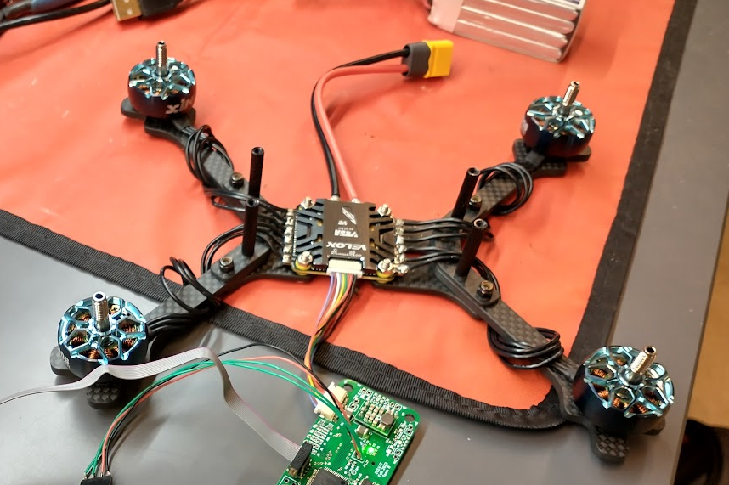
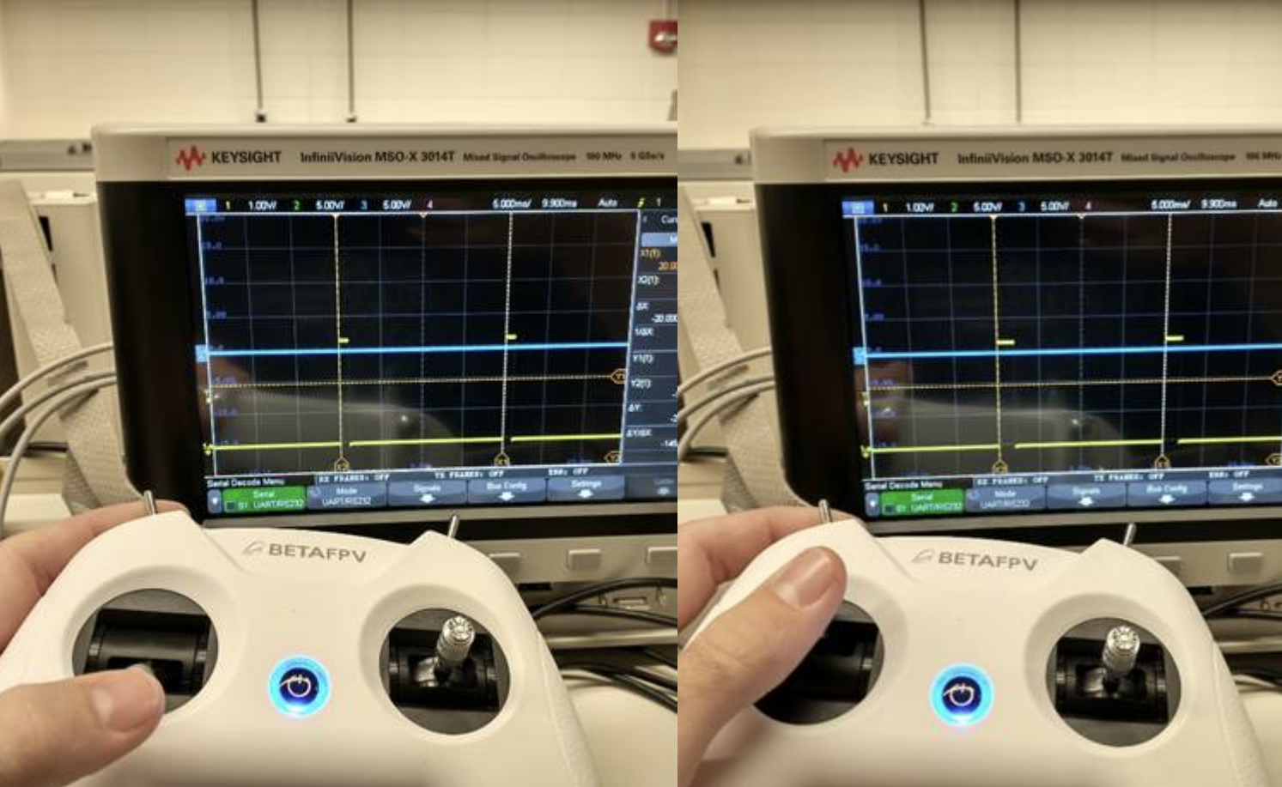
Motor Controller (ESC / Electronic Speed Controller)
The Motor controller will receive commands from the microcontroller and will transmit information to the motors via PWM. OneShot125 is a common PWM protocol for high speed motor control communication.
Credit: racedayquads

